Slide 1
Data Science for Everyone – Visualization Pt 2
Dr. Ab Mosca (they/them)
Slides based off slides courtesy of Jordan Crouser (https://jcrouser.github.io/)

Slide 2
Plan for Today
Visualization Guiding Principles
Visualization Ethics

Slide 3
Visualization Guiding Principles

Slide 4
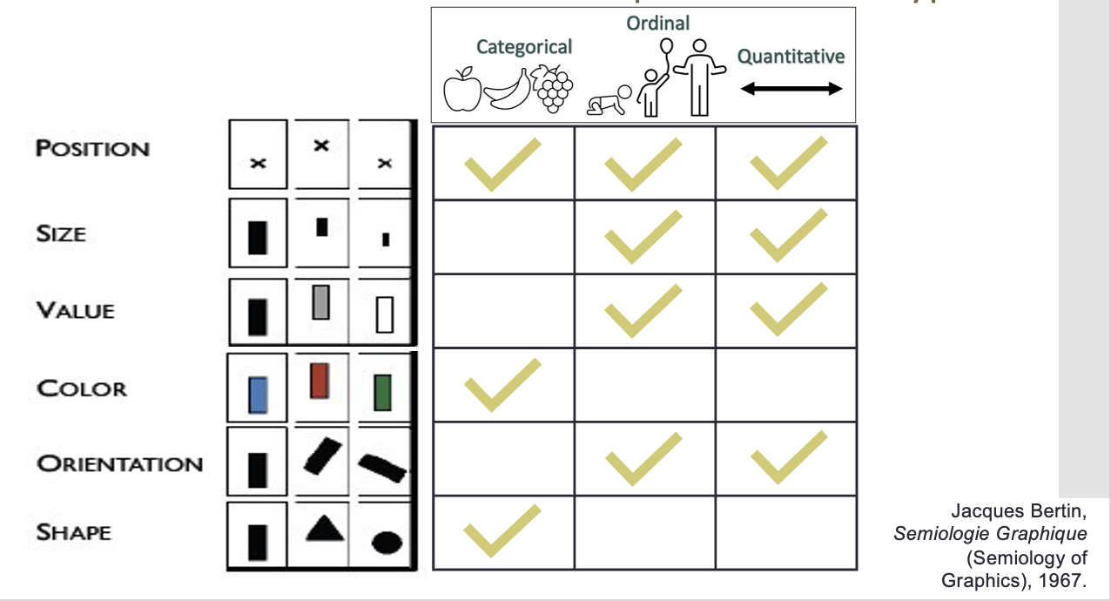
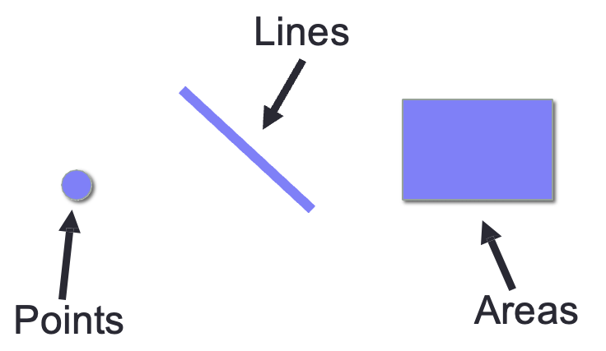
Recall
Visualizations (i.e. visual encodings) are made up of marks and channels
We select marks and channels based on goals, data, and other principles
Channels
Marks

Slide 5
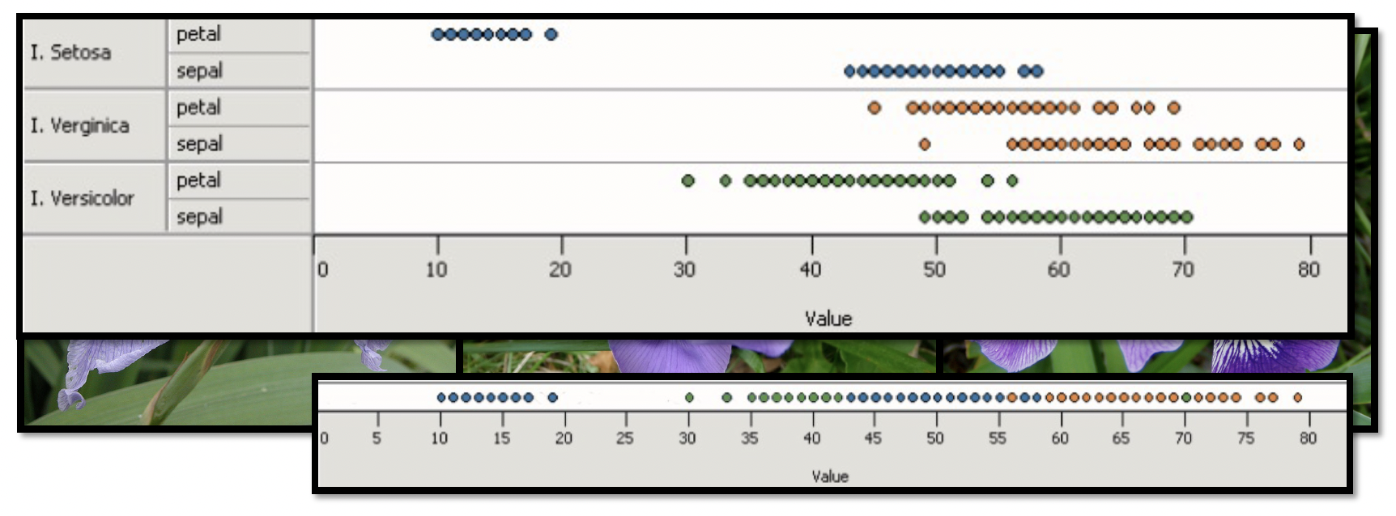
Mapping Data → Visuals
Principle 1: Expressiveness
Encode all the facts and only the facts
What data is in the top chart and not in the bottom chart?
Fig. Courtesy of M Krzywinski

Slide 6
Mapping Data → Visuals
Principle 1: Expressiveness
Encode all the facts and only the facts
What data is in the top chart and not in the bottom chart?
Fig. Courtesy of M Krzywinski

Slide 7
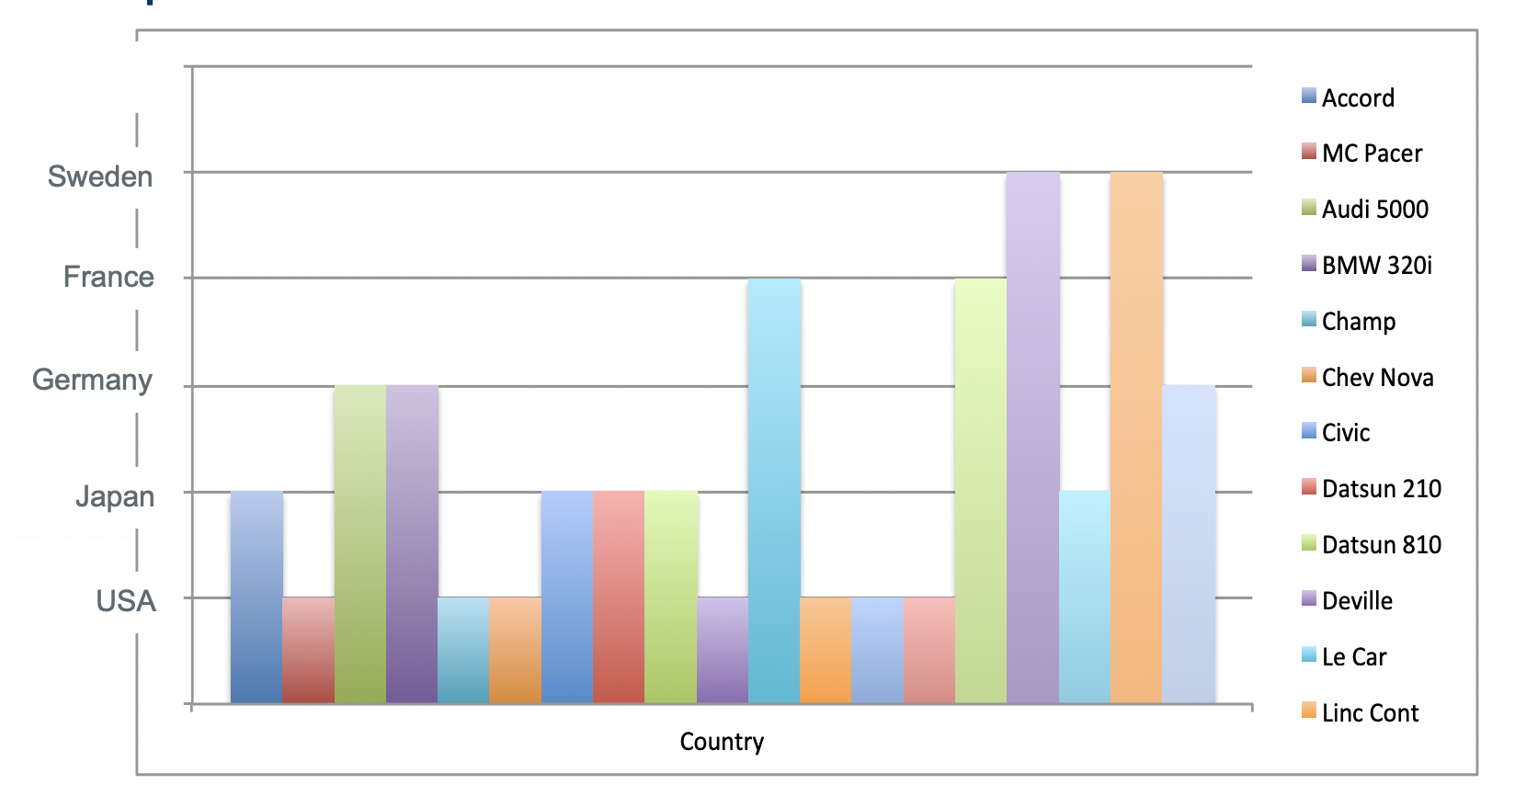
Mapping Data → Visuals
Principle 1: Expressiveness
Encode all the facts and only the facts
What “extra” data is included in this visualization?

Slide 8
Mapping Data → Visuals
Principle 1: Expressiveness
Encode all the facts and only the facts
What “extra facts” are included in this visualization?

Slide 9
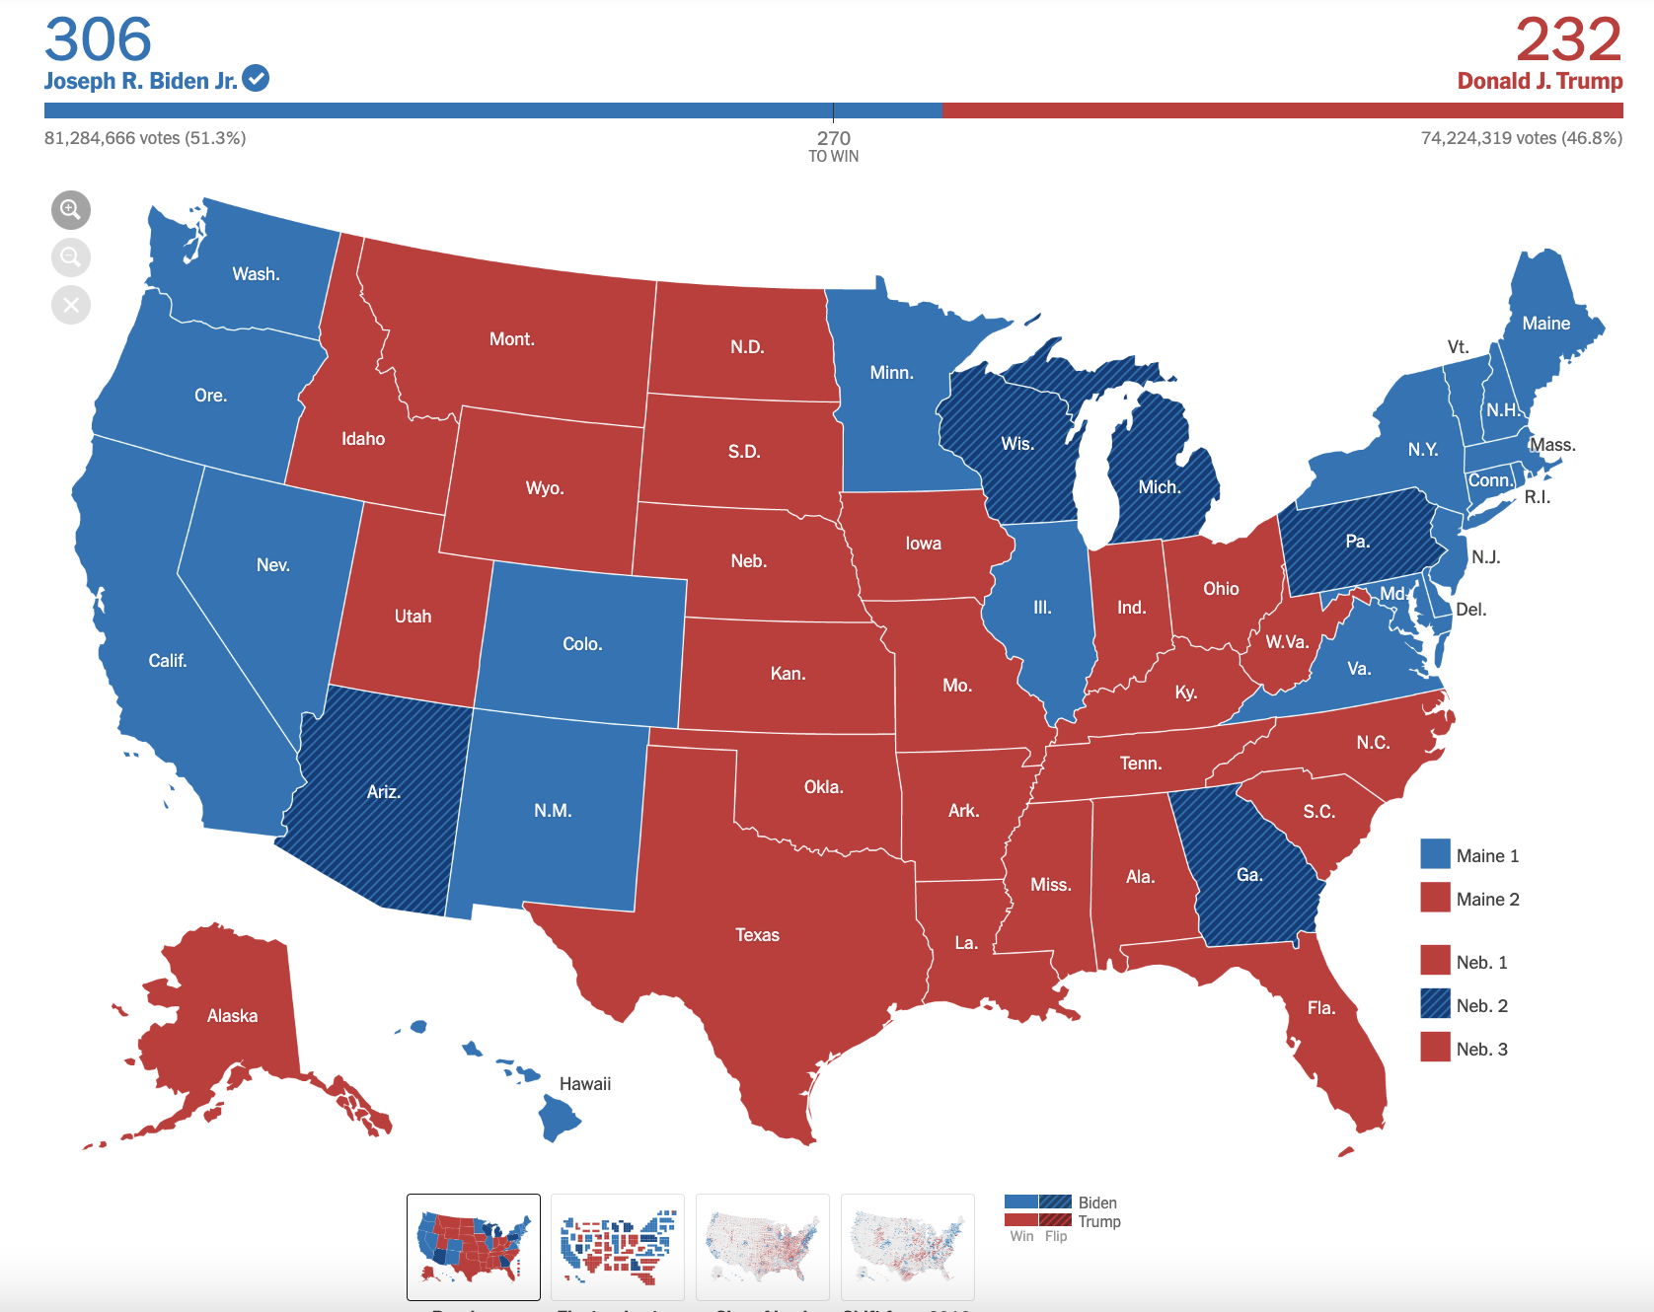
Mapping Data → Visuals
Principle 1: Expressiveness
Encode all the facts and only the facts
What is wrong with this visualization?
https://www.nytimes.com/interactive/2020/11/03/us/elections/results-president.html

Slide 10
Mapping Data → Visuals
Principle 1: Expressiveness
Encode all the facts and only the facts
Most electoral votes win
Colors highlight land area per state, not electoral votes
What is wrong with this visualization?
https://www.nytimes.com/interactive/2020/11/03/us/elections/results-president.html

Slide 11
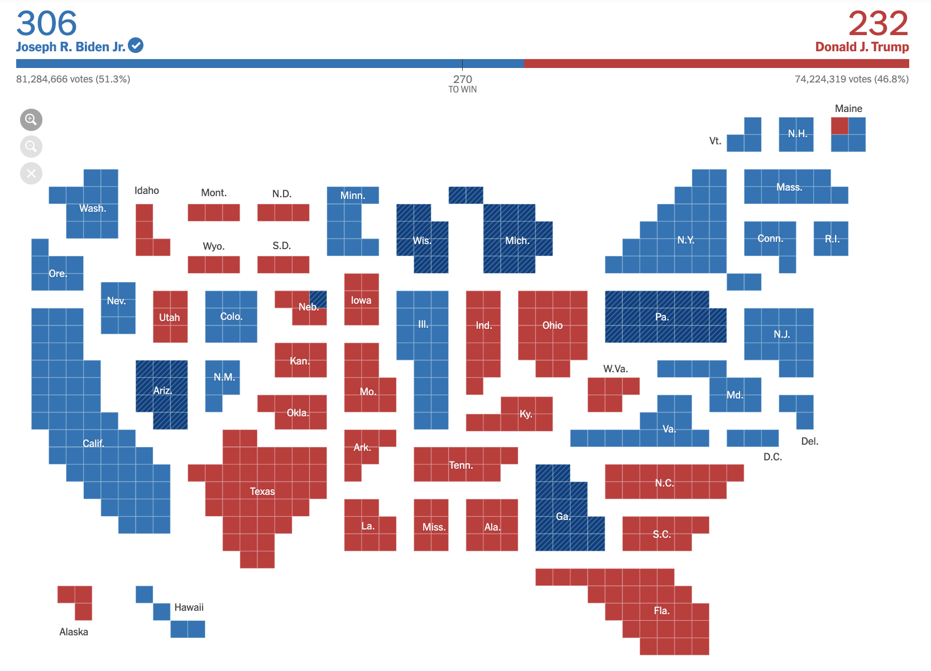
Mapping Data → Visuals
Principle 1: Expressiveness
Encode all the facts and only the facts
Most electoral votes win
Colors highlight electoral votes per state
https://www.nytimes.com/interactive/2020/11/03/us/elections/results-president.html

Slide 12
Mapping Data → Visuals
Principle 2: Effectiveness
Most effective channels should be used for most important data
Effectiveness = Based on a compilation of research, how well a channel supports:
Accuracy
Discriminability
Separability
Visual popout
Grouping

Slide 13
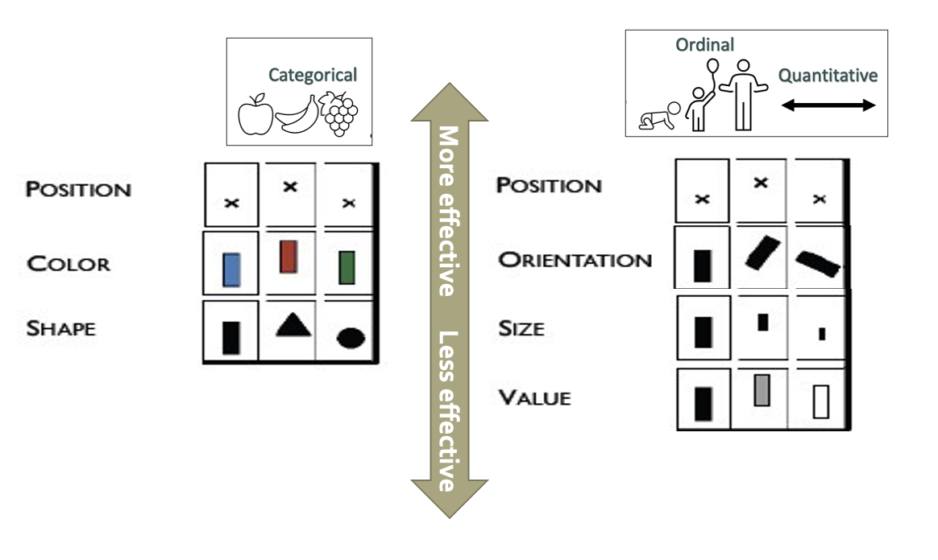
Mapping Data → Visuals
Principle 2: Effectiveness
Most effective channels should be used for most important data

Slide 14
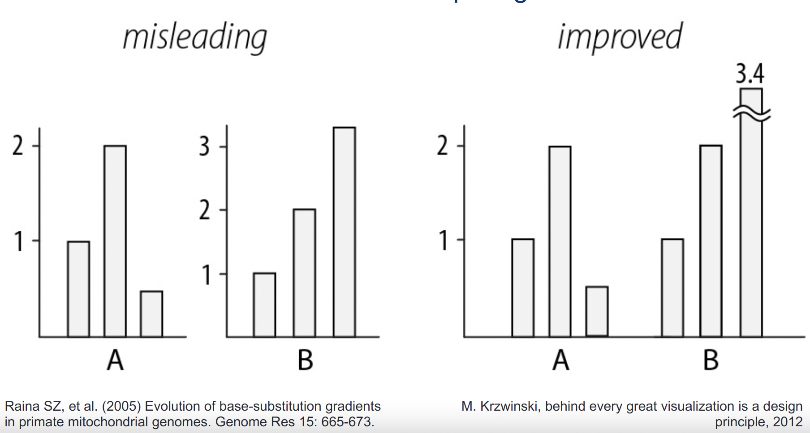
Mapping Data → Visuals
Principle 3: Consistency
Use consistent axes for comparisons

Slide 15
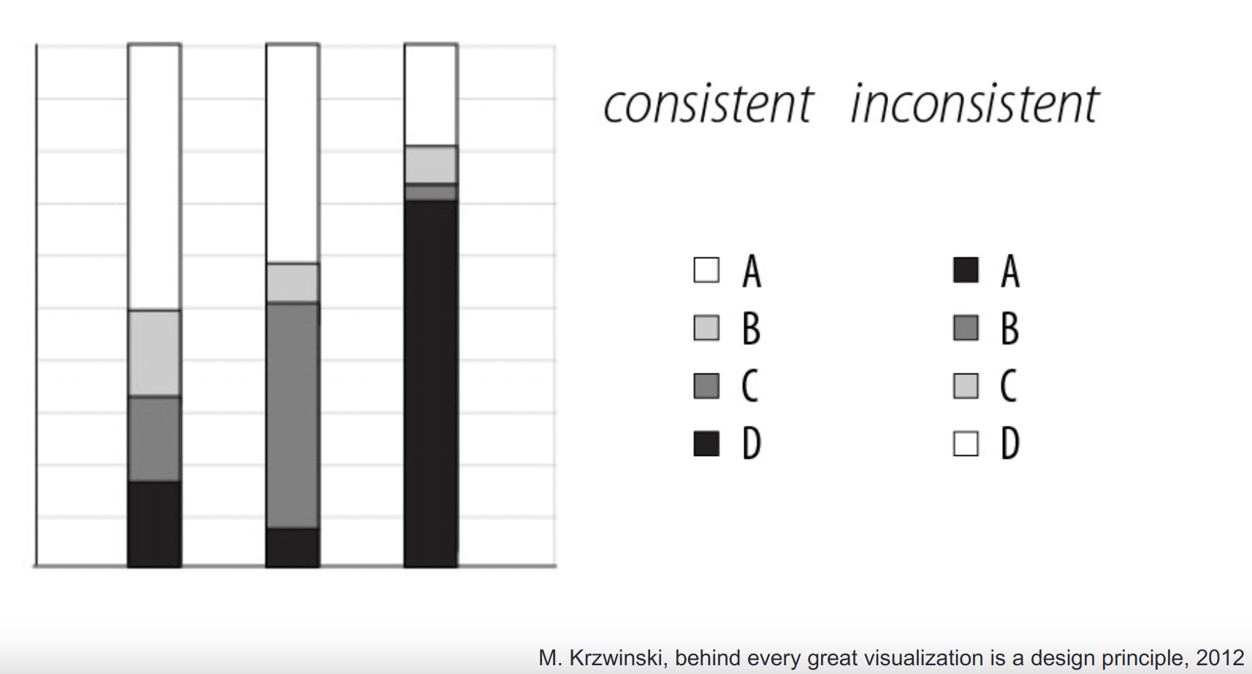
Mapping Data → Visuals
Principle 3: Consistency
Order legend items according to appearance

Slide 16
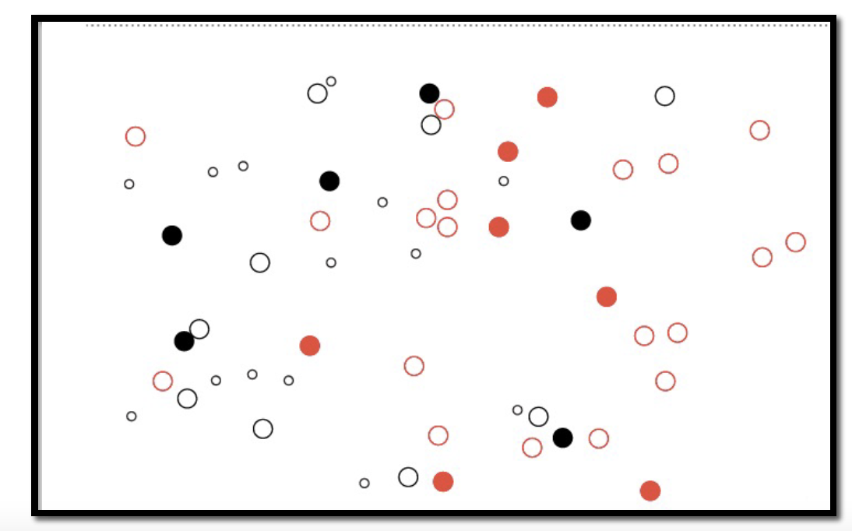
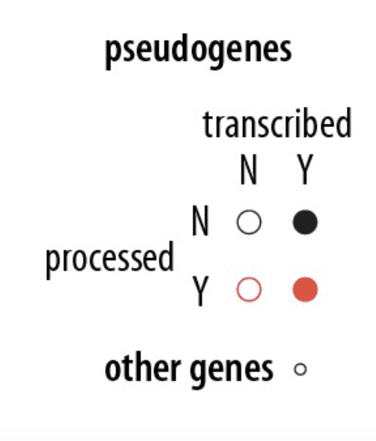
Mapping Data → Visuals
Principle 3: Separability
Avoid visually similar encodings for independent variables

Slide 17
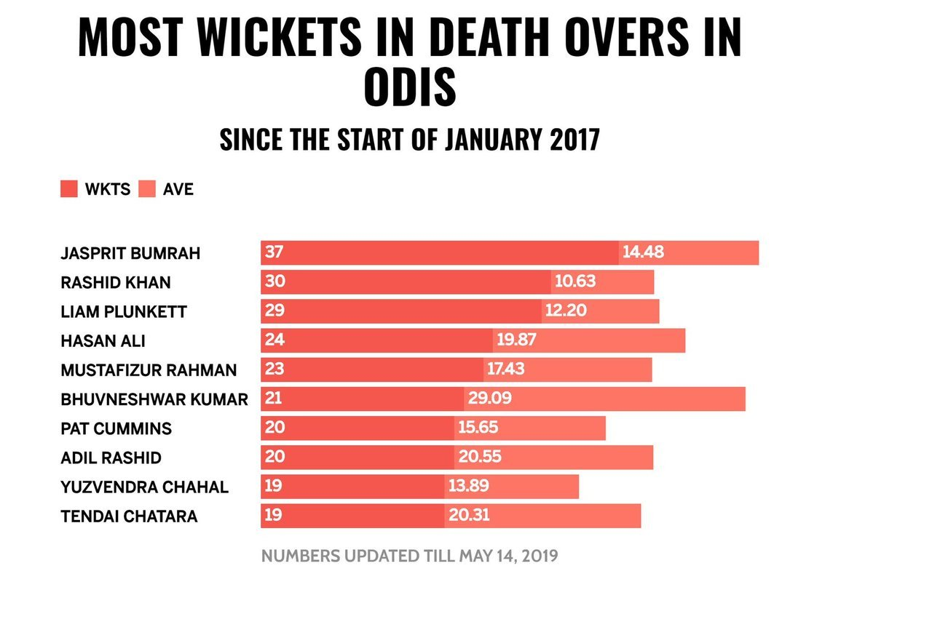
Mapping Data → Visuals
Principle 3: Separability
Avoid visually similar encodings for independent variables
https://www.syntaxtechs.com/blog/data-visualization-examples

Slide 18
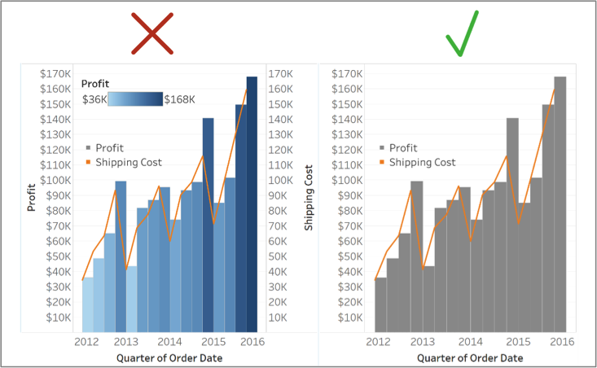
Mapping Data → Visuals
Principle 4: Simplicity
Avoid double encoding data
https://www.teknionusa.com/blog/the-10-commandments-of-visual-analytics-in-tableau

Slide 19
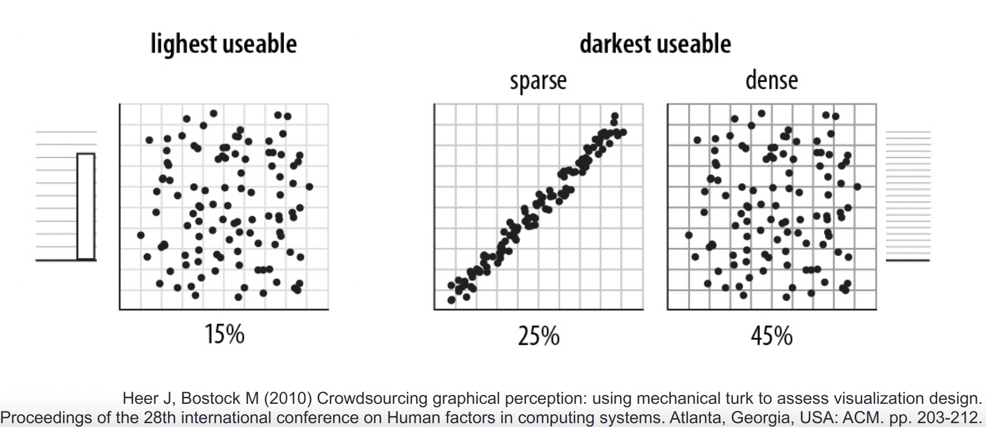
Mapping Data → Visuals
Principle 4: Simplicity
Navigational aids should not compete with data

Slide 20
Responsible Creation and Consumption of Vis

Slide 21
How to visualize data?
Goal → What do you want to communicate or facilitate?
Data Types → What kinds of data do you need to show?
Notes:
So we know why we use visualization, some of it’s benefits. And we looked at what are hopefully some compelling examples as to why it’s helpful.
Now, let’s talk about how to visualize data.
The first things I want you to think about when you’re selecting a visualization are your goal, i.e. what you want to show, and the type of data you are working with.

Slide 22
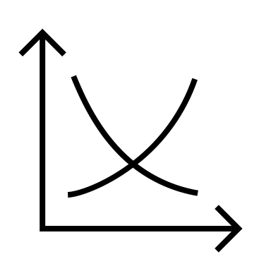

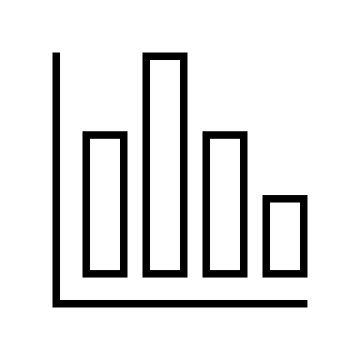
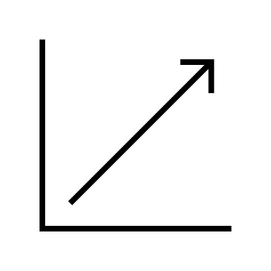


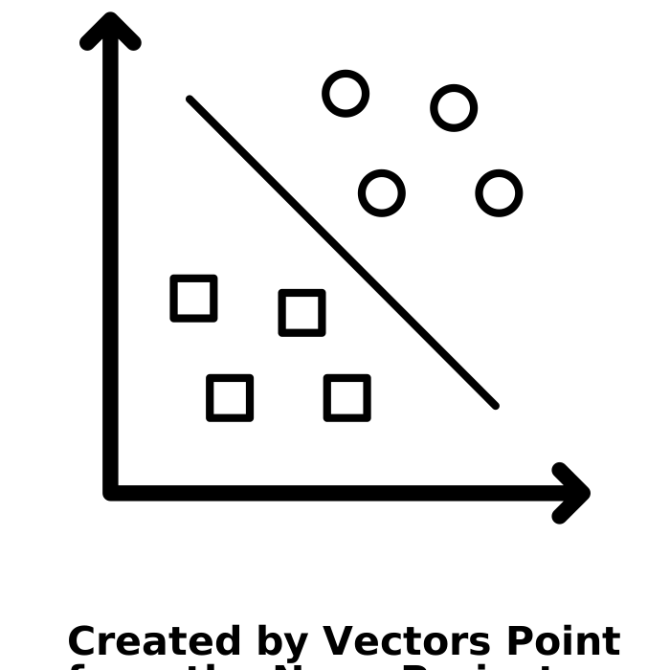
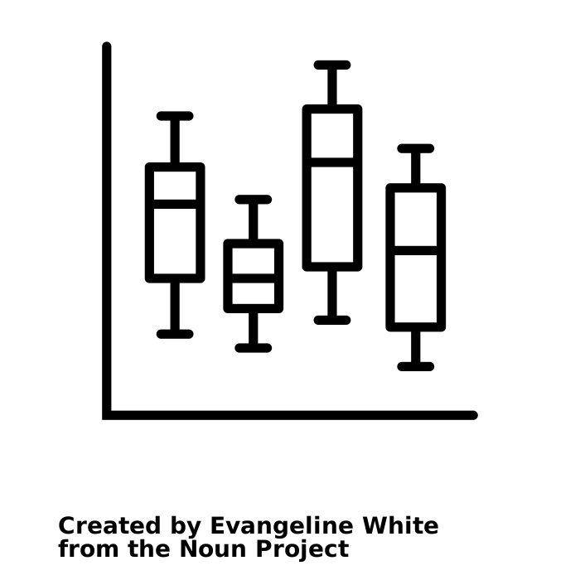

How to visualize data?
Goal → What do you want to communicate or facilitate?
Data Types → What kinds of data do you need to show?
Comparison
Trend
Outliers
Notes:
Let’s start by talking about goals. To determine your goal try to answer the question what am I trying to communicate or facilitate?
Your ultimate goal is going to help narrow what type of visualization is appropriate for your needs.
For example, I’ve written three common goals here, comparison, trend, outliers. You can see that each has a
<Go through each>
Sankey = flows

Slide 23






How to visualize data?
Goal → What do you want to communicate or facilitate?
Data Types → What kinds of data do you need to show?
Comparison
Trend
Outliers
Ordinal
Categorical
Quantitative
Notes:
The second thing to think about is what kinds of data you are trying to visualize
Similar to goal, the types of data you want to show will limit the number of appropriate visualizations you can make
The main types of data we will think about for today are categorical, ordinal, and quantitative
Categorical data is data that fits into categories that have no inherent ordering. Ex. Fruit, Other examples?
Ordinal data is data that fit into categories that do have an inherent ordering. Ex. Baby, toddler, child, adult. Other examples?
Quantitative data is continuous data. Ex. Temperature, costs, counts. Other examples?
Now, let’s look at how these two things (goals and data types) play into choosing bar charts and line charts.

Slide 24
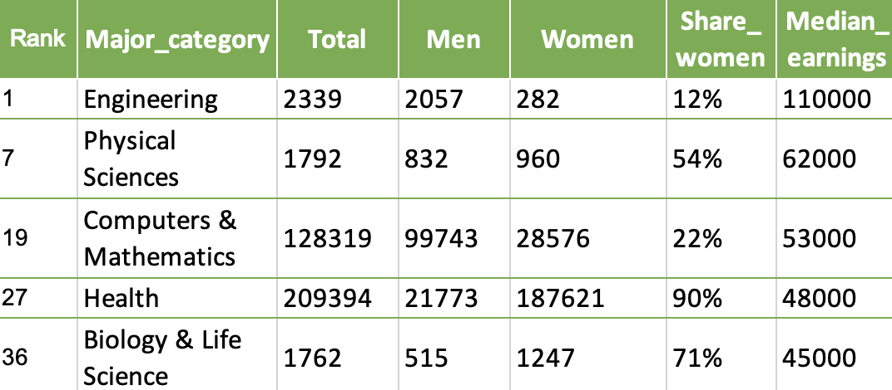
How to visualize data?
Goal → What do you want to communicate or facilitate?
Data Types → What kinds of data do you need to show?
Comparison
Trend
Outliers
Notes:
Let’s ground this by looking at an example.
What are the categorical attributes in this dataset?
How about quantitative and ordinal?
Next, let’s look at how these two things (goals and data types) play into choosing two common visualizations: bar charts and line charts.

Slide 25
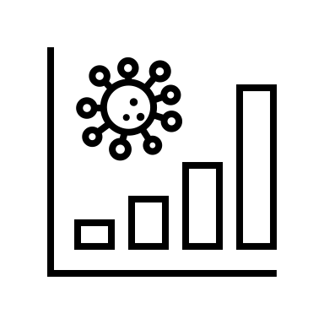
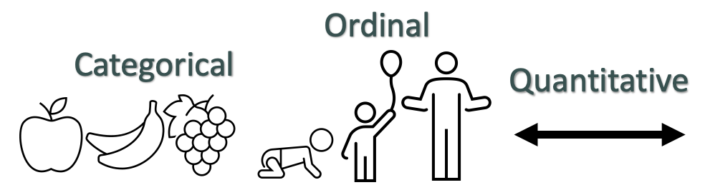
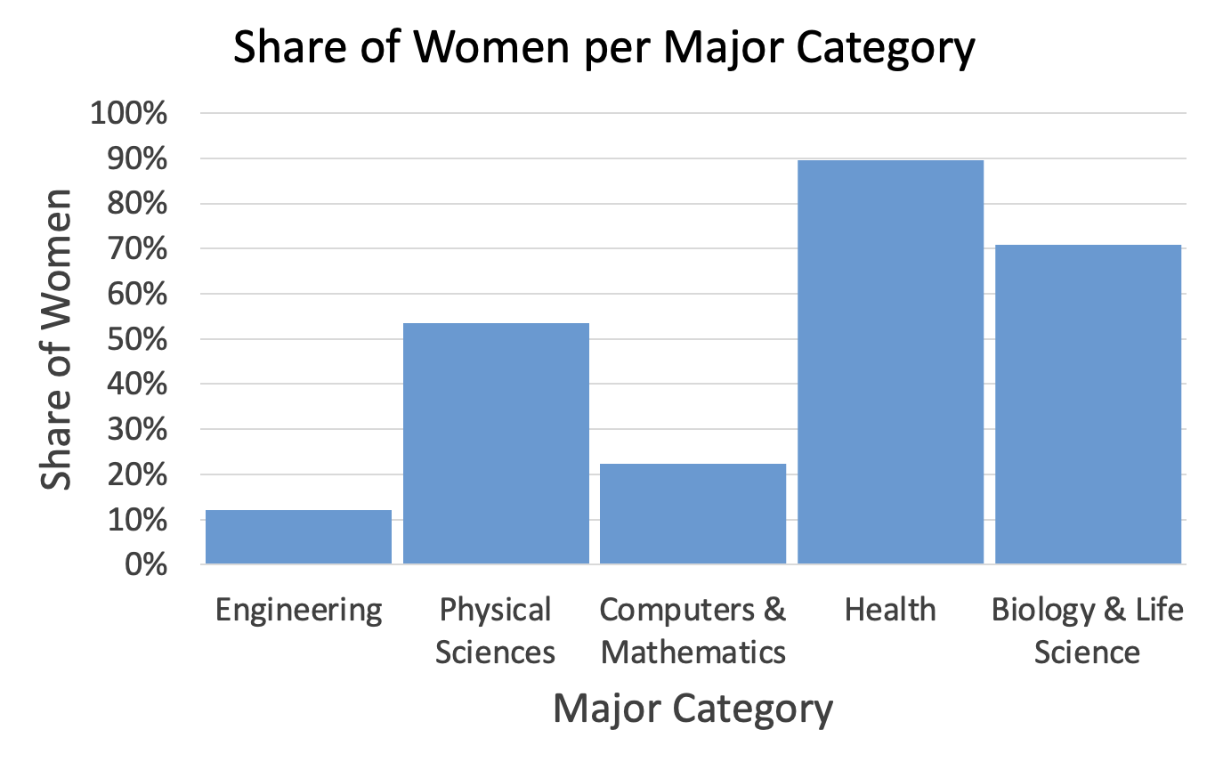
Bar charts
Goal → Comparison
Data Types → Categorical or Ordinal vs. Quantitative
Data: https://github.com/fivethirtyeight/data/blob/master/college-majors/women-stem.csv
Notes:
Let’s start by looking at bar charts.
We use bar charts when our goal is to enable comparisons of quantitative data between categorical or ordinal groups.
Let’s say for example that we want to compare share or women by major category from the previous dataset.
We can do this with a bar chart that shows our groups, major category, on the x-axis, and our quantitative data, share of women, on the y axis.
Notice how this set up makes it really easy to compare the share of women across these different majors.

Slide 26
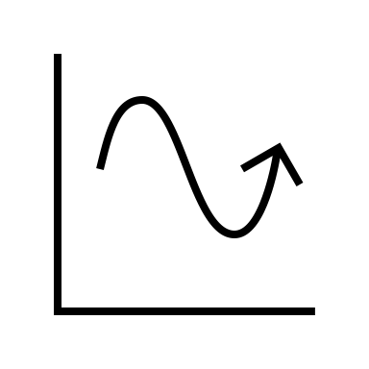
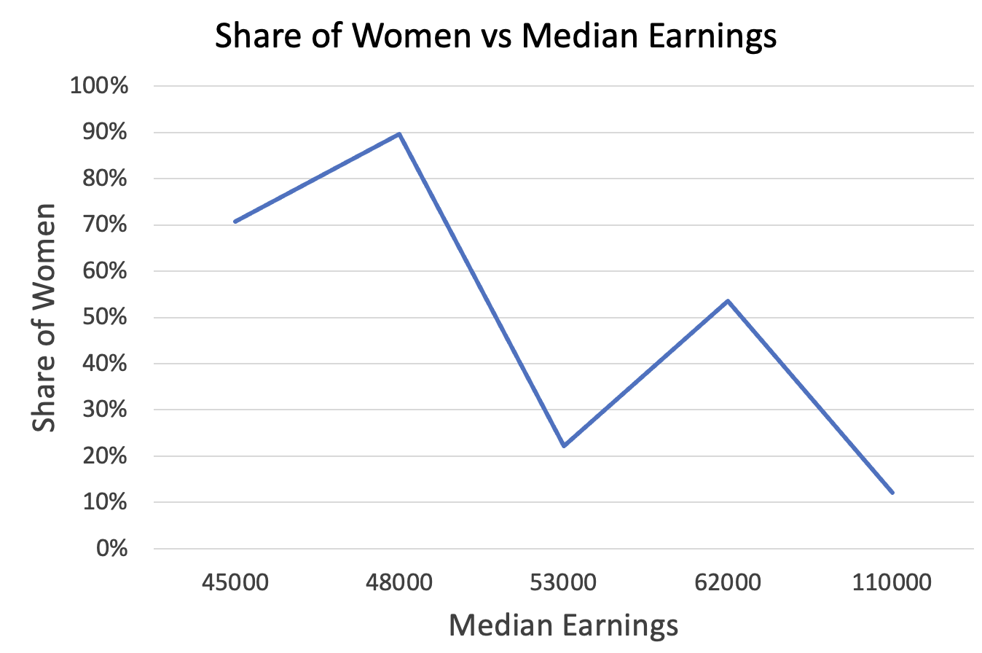
Line charts
Goal → Trend
Data Types → Ordinal or Quantitative vs. Quantitative
Data: https://github.com/fivethirtyeight/data/blob/master/college-majors/women-stem.csv
Notes:
Next, let’s look at line charts.
Line charts are appropriate when we want to view a trend in quantitative data versus some other quantitative or ordinal data.
Let’s say for example here we want to see the trend in share of women as median earnings increases. A line chart with median earning on the x-axis and share of women on the y-axis accomplishes this goal.

Slide 27
Avoiding Bias and Trickery

Slide 28
How do we avoid bias & trickery?
Inspect the data
→ Source?
→ Biases?
Data: https://github.com/fivethirtyeight/data/blob/master/college-majors/women-stem.csv
Notes:
The last thing I want us to think about is avoiding bias and trickery in the visualization we make, and when we’re reading visualizations designed by others.
The first thing to think about when you look at any visualization is your data source and potential biases. Who collected the data being visualized? Was it collected in a way that creates biases? Things to look for include over collection of one group and lack of representation of other groups, poor (or undisclosed) data cleaning practices, etc..
For example, if we look at this example dataset, can anyone point out any biases?

Slide 29
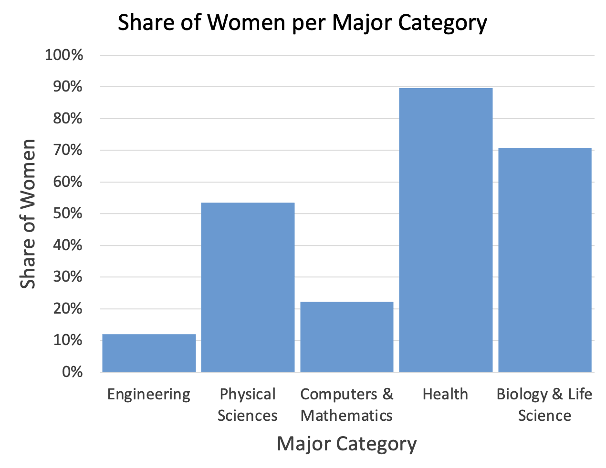
How do we avoid bias & trickery?
Design Contentiously & Read Critically
→ What’s shown vs not?
Data: https://github.com/fivethirtyeight/data/blob/master/college-majors/women-stem.csv
Notes:
Even if we don’t have access to raw data, careful critical reading of visualizations can show biases present in the under laying data.
For example, you could look at either of these charts and postulate that the underlaying data might only be divided into women and not women and therefore misses groups of people.

Slide 30
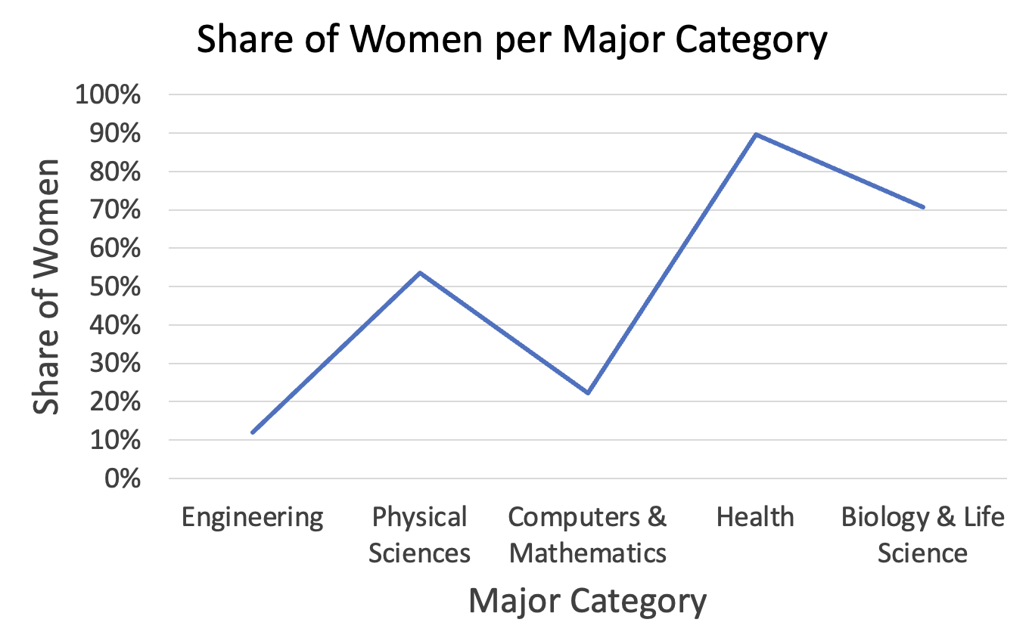
How do we avoid bias & trickery?
Design Contentiously & Read Critically
→ Goal
→ Data types
Data: https://github.com/fivethirtyeight/data/blob/master/college-majors/women-stem.csv
Notes:
Another point to think about is designing contentiously and reading critically.
We know goals and data types inform what kind of visualization is appropriate to use. And we can use this information to inform our reading of visualizations.
For example, can anyone point out the issue with this chart based on what we just discussed with respect to line charts?

Slide 31
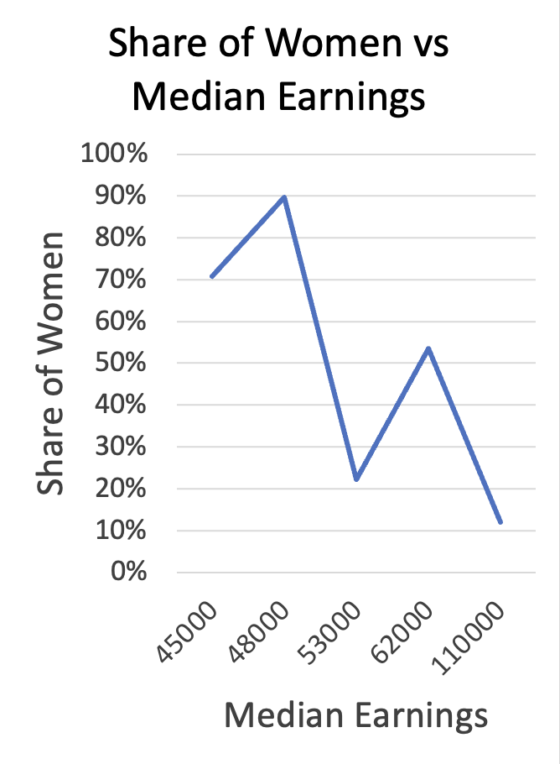
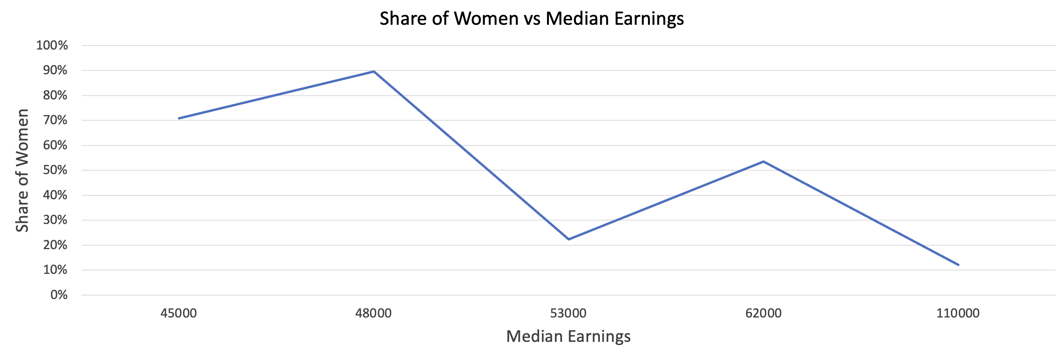
How do we avoid bias & trickery?
Design Contentiously & Read Critically
→ Aspect ratio
Data: https://github.com/fivethirtyeight/data/blob/master/college-majors/women-stem.csv
Notes:
Another way that visualizations can be deceptive is through the aspect ratio chosen for them.
For example here I’m showing one chart with 3 different aspect ratios. You can see when I stretch the chart width-wise, my changes look much less dramatic.
Likewise, when I squish it width-wise my changes look far more dramatic.

Slide 32
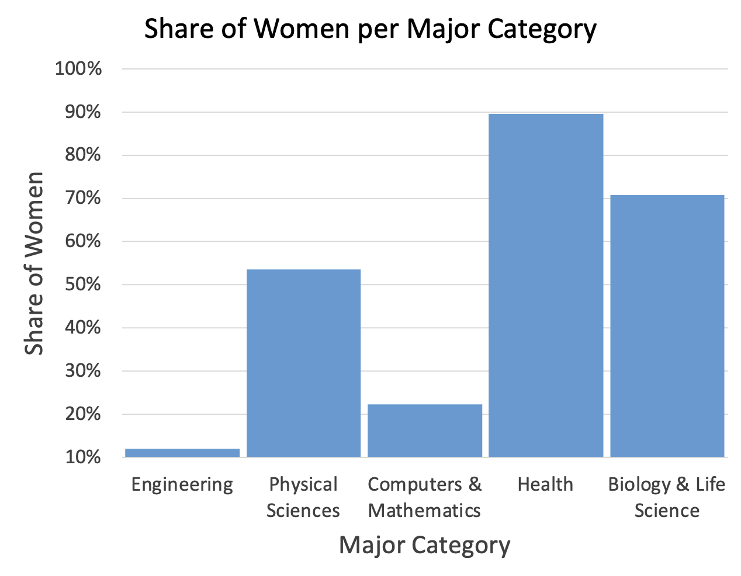
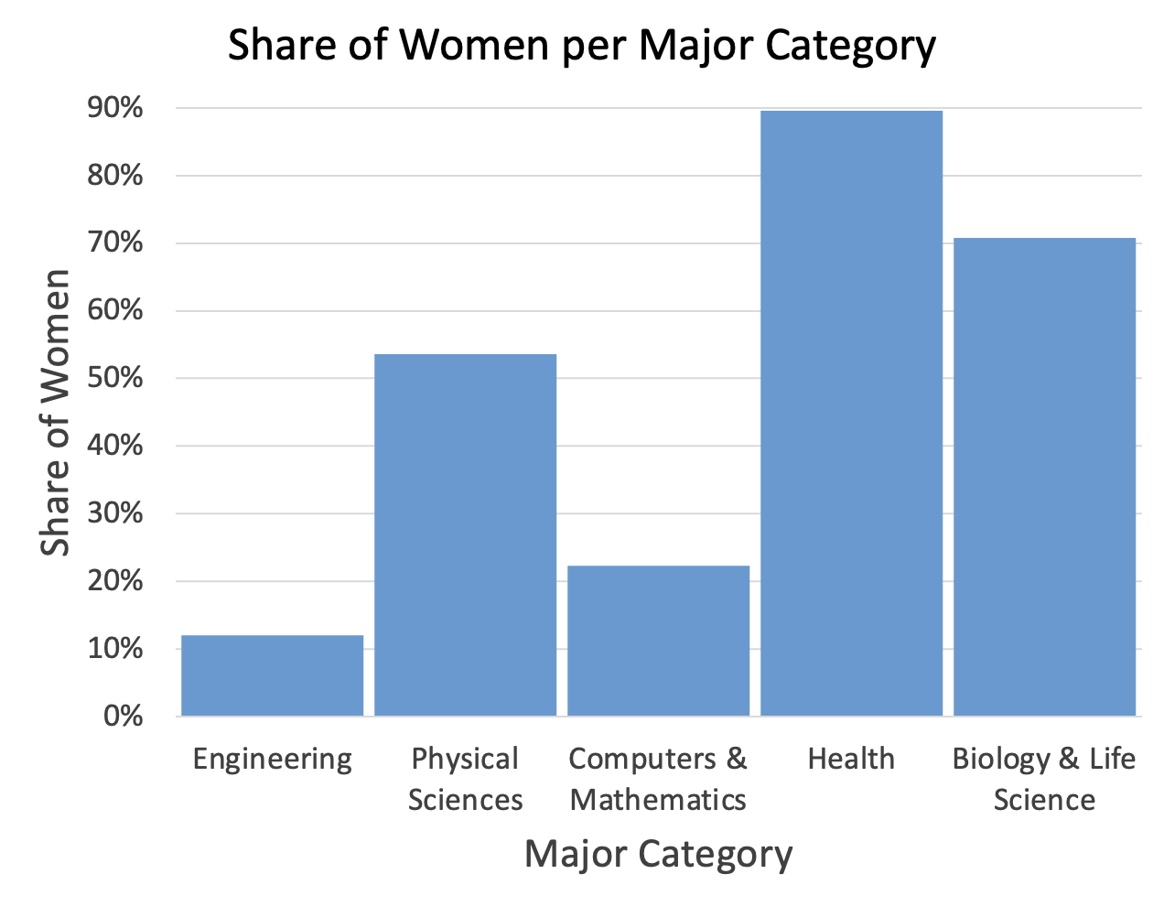
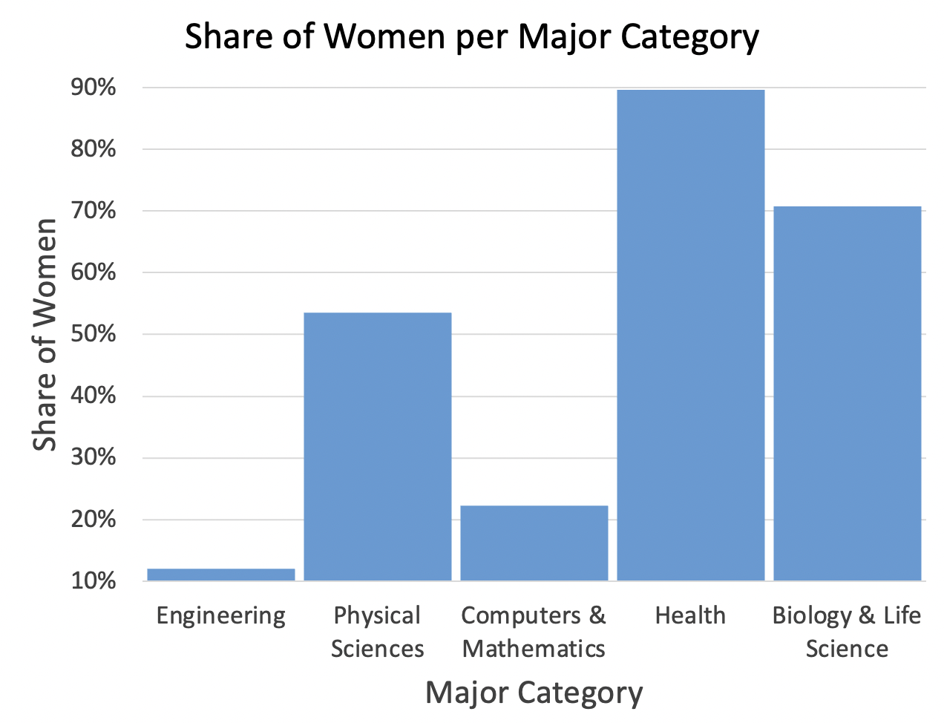
How do we avoid bias & trickery?
Design Contentiously & Read Critically
→ Axes
Data: https://github.com/fivethirtyeight/data/blob/master/college-majors/women-stem.csv
Notes:
Last but not least, another way to bias a chart is by choosing unexpected or unusual axis ranges. For example here I have the same data plotted 4 times. In each plot I use a different range of values on the y-axis.
The first is chosen to make engineering look even smaller, the second is chosen to make health look even better, and the third employs both of these tricks at once.

Slide 33
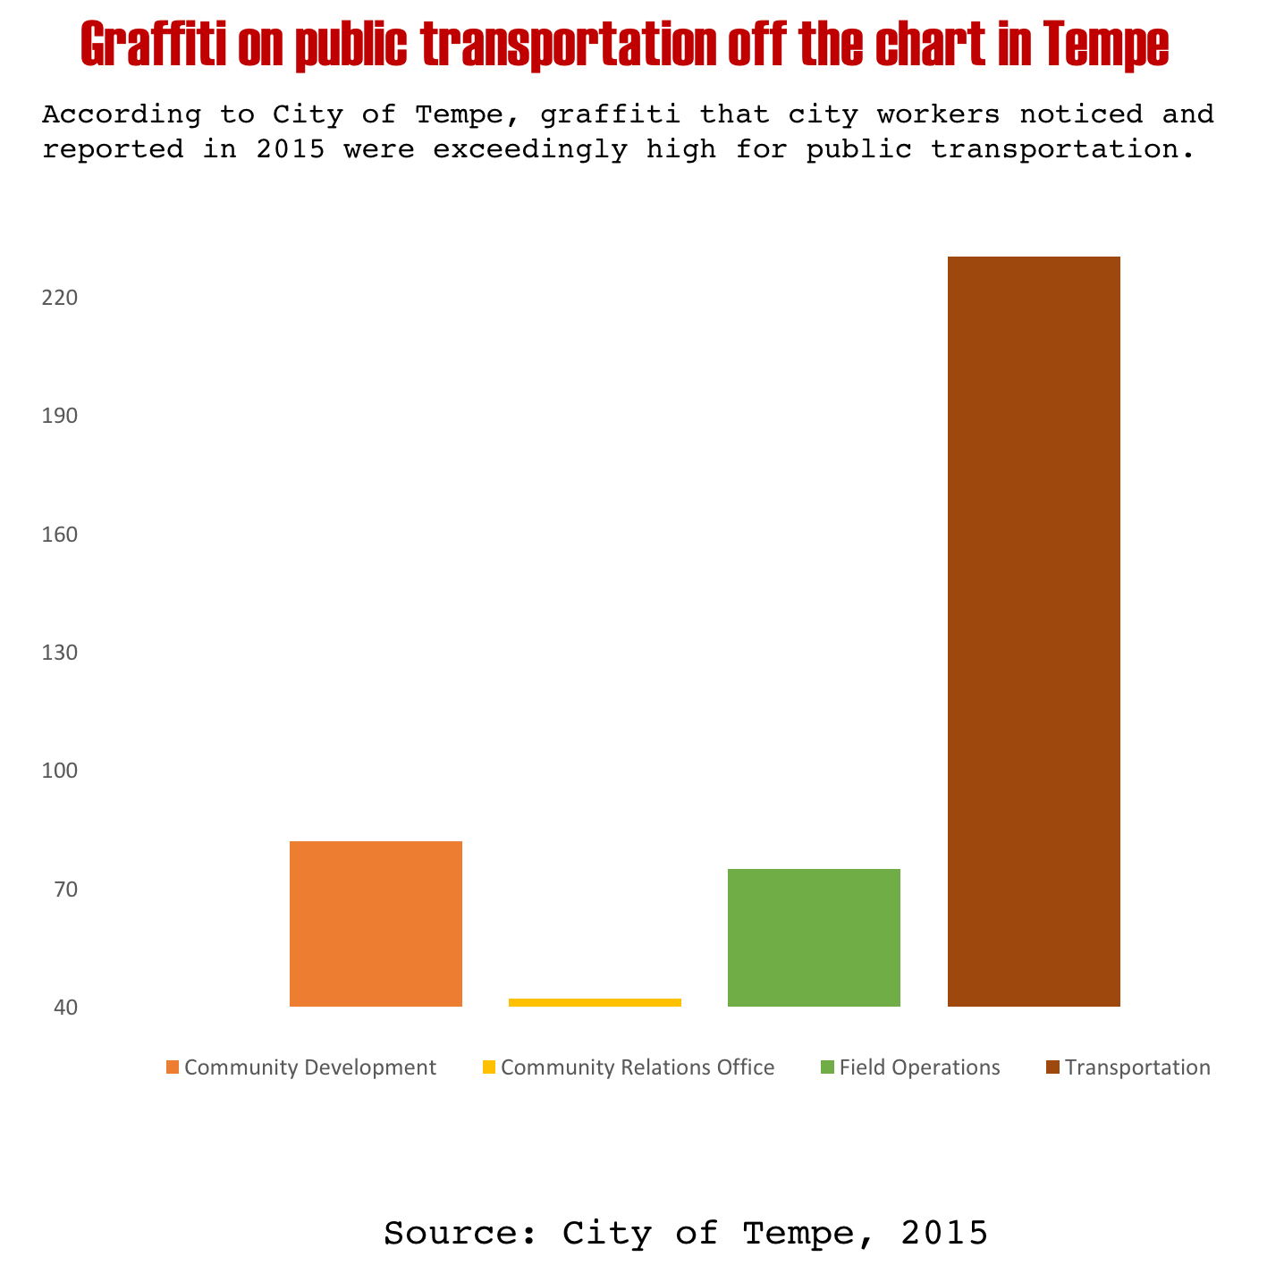
Let’s practice
Take a critical look at this chart. Notice anything?
https://www.vislies.org/2017/gallery/
Notes:
Strange categorization where one group is far larger than the others

Slide 34
Let’s practice
Take a critical look at this chart. Notice anything?
Re-design the chart (you can add more data if you want)
https://www.vislies.org/2017/gallery/
Notes:
Doesn’t start at 0,
Strange categories that don’t span a lot of area

Slide 35
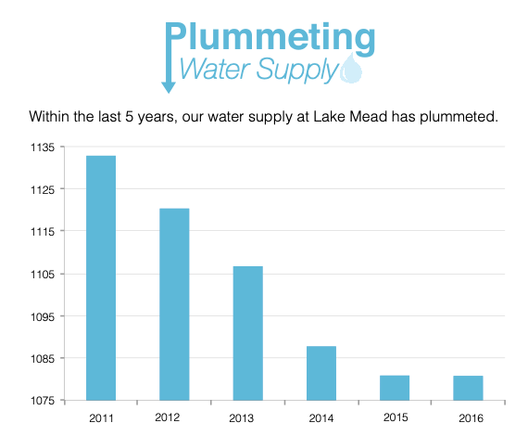
Let’s practice
Take a critical look at this chart. Notice anything?
https://www.vislies.org/2017/gallery/
Notes:
Super tiny range shown on the y-axis

Slide 36
Let’s practice
Take a critical look at this chart. Notice anything?
Re-design the chart (you can add more data if you want)
https://www.vislies.org/2017/gallery/

